Slide 1
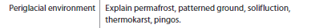
EXPLAIN PERIGLACIAL FEATURES AND LANDFORMS

Slide 2
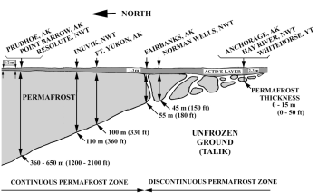
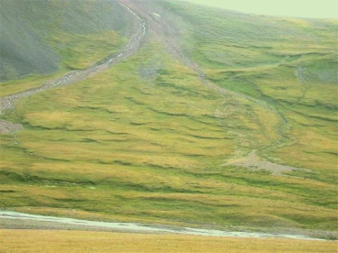
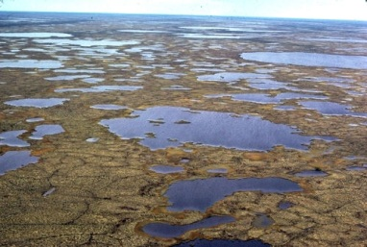
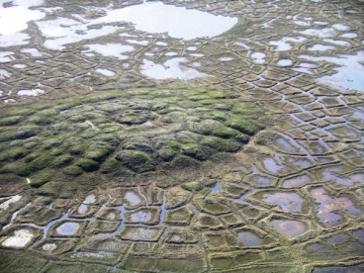
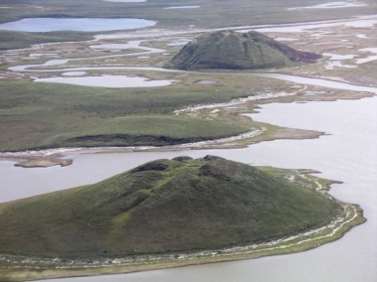
 | PERMAFROST | SOLIFLUCTION | THERMOKARST | PATTERNED GROUND | PINGO’S
IMAGE
DESCRIPTION
FORMATION
EXAMPLES

Slide 3

Pingos

Slide 4
Patterned Ground

Slide 5
http://news.bbc.co.uk/2/hi/science/nature/2665675.stm
FROST HEAVE and PATTERNED GROUND

Slide 6
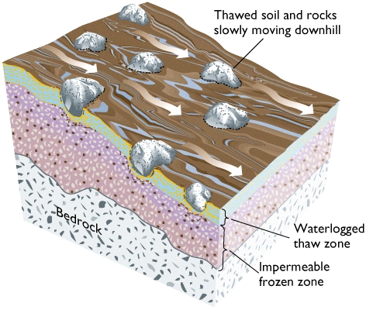
SOLIFLUCTION
Mass movement of soil and loose rock particles affected by alternate freezing and thawing.
Characteristic of saturated soils in high latitudes, both within and beyond the permafrost zone.

Slide 7
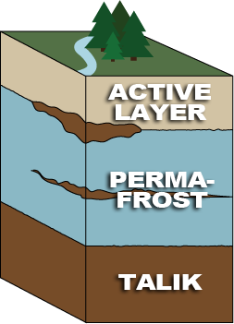
Permafrost
Permafrost is defined on the basis of temperature, as soil or rock that remains below 0°C throughout the year, and forms when the ground cools sufficiently in winter to produce a frozen layer that persists throughout the following summer.
Talik is unfrozen ground that lies below the permafrost and between the active layer and permafrost.

Slide 8
Permafrost Map of Alaska
http://www.youtube.com/watch?v=rPzKgnTDhqA 01:00 to 03:30
Watch remainder for homework.
Compare features of their journey to the permafrost map on handout.
Also, good links to human adaptation…

